Slide 1

Capstone Project

Slide 2



Personal BACKGROUND
Name : Kolla Bala Seswitha
Past Experience : Fresher
Qualification : B.Tech CSE HONOURS
Career Summary : Highly motivated and detail-oriented fresher with training in ELT Backend. Successfully completed a Capstone project based on Backend, demonstrating skills in Core Java, SpringBoot. Developed strong problem-solving, teamwork, and communication skills during training. Eager to apply my skills and knowledge in a real-world setting and continue learning and growing in this field.
www.collaberadigital.com

Slide 3


MY LEARNINGS FROM THIS CAPSTONE PROJECT
API Design & Development: Mastered RESTful API creation, documentation, and security best practices.
Data Management: Gained expertise in CRUD operations, complex queries, and maintaining data integrity.
System Integration: Integrated modules (customer, admin, product, order, cart) and handled real-time data synchronization.
Scalability & Performance: Implemented strategies for scalable systems, optimized performance, and conducted load testing.
Security Practices: Applied security measures, including authentication, authorization, and encryption.
User Experience: Learned to design user-friendly APIs and documentation for better user experience.
Project Management: Managed project requirements, timelines, and module coordination effectively.

Slide 4

Problem Statement of the Capstone Project
Objective: Develop a robust online shopping platform with modules for customer, admin, product, order, and cart management.
Modules:
Customer Management
CRUD Operations: Create, read, update, delete.
Queries: By ID, name, city, pincode.
Admin Management
CRUD Operations: Create, read, update, delete.
Queries: By ID, name, city, pincode.
Product Management
CRUD Operations: Create, read, update, delete.
Queries: By ID, name, category, price.
Order Processing
CRUD Operations: Create, read, update, delete.
Queries: By date, customer ID, price, product.
Cart Processing
CRUD Operations: Create, read, update, delete.
Operations: Add, remove, view items.
-Requirements: Implement RESTful APIs, Ensure data integrity and security, Design for scalability and performance.

Slide 5
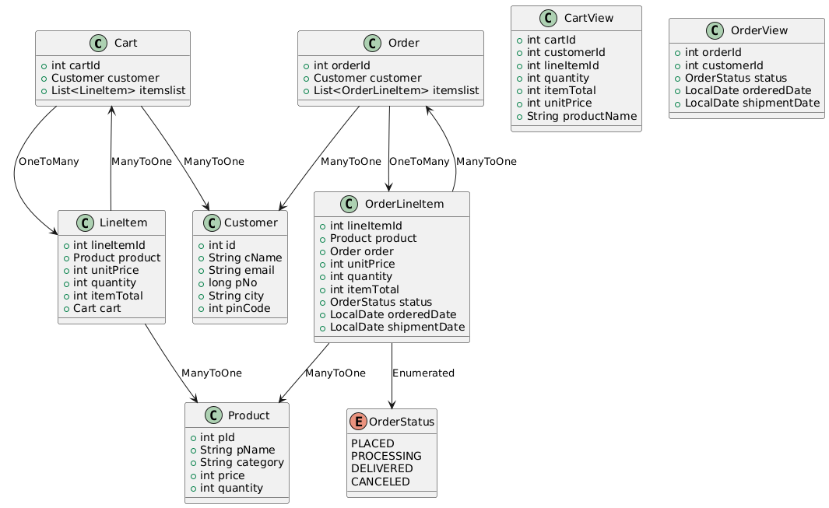
CLASS DIAGRAM OF THE PROJECT
The Cart class contains a unique cartId and is associated with a single Customer (Many-to-One) and multiple LineItems (One-to-Many). Customer holds details like id, cName, email, etc., and can be linked to multiple carts and orders.
LineItem has a lineItemId and attributes such as quantity and unitPrice. Each line item is linked to one Cart and one Product (Many-to-One relationships).
The Order class tracks orders with orderId and connects to a single Customer (Many-to-One) and multiple OrderLineItems (One-to-Many). OrderLineItem contains lineItemId, quantity, status, and is linked to one Order and one Product.
The Product class, identified by pId, stores product details like pName, category, price, and quantity, and can be referenced by multiple line items and order line items.

Slide 6
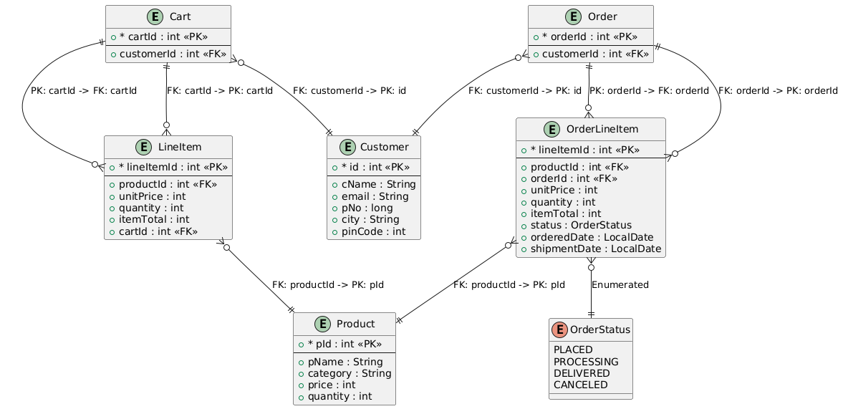
ENTITY RELATIONSHIP DIAGRAM OF THE PROJECT
The Cart entity is identified by cartId and contains a foreign key reference to Customer (customerId). A Customer can have multiple carts (One-to-Many). Cart also maintains a relationship with LineItem (One-to-Many), where each line item belongs to a single cart.
LineItem contains foreign keys referencing Cart and Product, forming a Many-to-One relationship with both. Each LineItem refers to one Product, and each product can be referenced by multiple line items.
The Order entity is linked to Customer via customerId (Many-to-One), and each order can contain multiple OrderLineItems (One-to-Many). OrderLineItem contains foreign keys to Order and Product, meaning each line item belongs to a single order and refers to a specific product.
The Product entity, identified by pId, can be associated with multiple LineItems and OrderLineItems through its relationships.

Slide 7

APPLICATION ARCHITECTURE
Overview:
Layered Architecture: The application follows a structured design with distinct layers for managing data and business logic.
DTO (Data Transfer Object): Defines data structures for transferring data between layers.
DAO (Data Access Object): Handles data persistence and retrieval, interfacing with the database.
Service: Contains business logic, interacting with DAOs and providing data to Controllers.
Controller: Manages HTTP requests, interacts with Services, and returns responses.
DTO Layer:
Cart: Represents a shopping cart with cartId, customer, and a list of LineItems.
Customer: Contains customer details like id, cName, email, and pinCode.
Product: Defines product attributes such as pId, pName, category, price, and quantity.
Order: Represents an order with orderId, customer, and a list of OrderLineItems.
OrderLineItem: Contains order-specific details including lineItemId, product, unitPrice, quantity, itemTotal, and status.

Slide 8

APPLICATION ARCHITECTURE
Mappings/Entity Relationships:
Cart:
@ManyToOne: Cart belongs to a Customer.
@OneToMany: Cart contains multiple LineItems.
Customer:
Can have multiple Carts and Orders.
LineItem:
@ManyToOne: LineItem belongs to a Cart and refers to a Product.
Order:
@ManyToOne: Order belongs to a Customer.
@OneToMany: Order contains multiple OrderLineItems.
OrderLineItem:
@ManyToOne: OrderLineItem belongs to an Order and refers to a Product.

Slide 9
APPLICATION ARCHITECTURE
CONTROLLER LAYER:
CartController: Manages cart operations such as adding/removing items, viewing cart contents, and placing orders.
Endpoints: /addToCart, /removeFromCartByQuantity, /removeFromCart, /removeCart, /viewCart, /viewAllCarts, /placeOrder, /placeOrderNproducts
CustomerController: Handles CRUD operations for customers.
Endpoints: /add, /update, /displayAll, /deleteById/{id}, /findById/{id}, /findBycName/{cName}, /findByCity/{city}, /findByPincode/{pincode}
OrderController: Manages order operations including creating and canceling orders, and viewing order details.
Endpoints: /createOrder, /cancelOrder, /viewOrder
ProductController: Manages product operations.
Endpoints: /addProduct, /updateProduct, /deleteById/{pId}, /findAll, /findById/{pId}, /findByName/{pName}, /findByCategory/{category}
Repositories:
CartRepository, CustomerRepository, OrderRepo, ProductRepository: Interface with the database to handle CRUD operations.

Slide 10
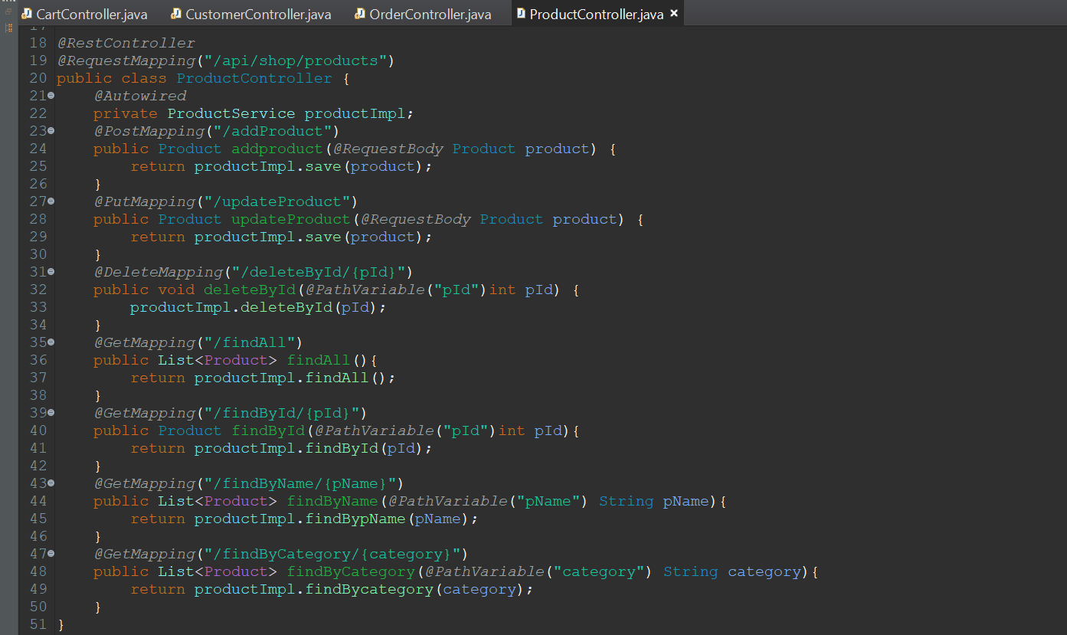
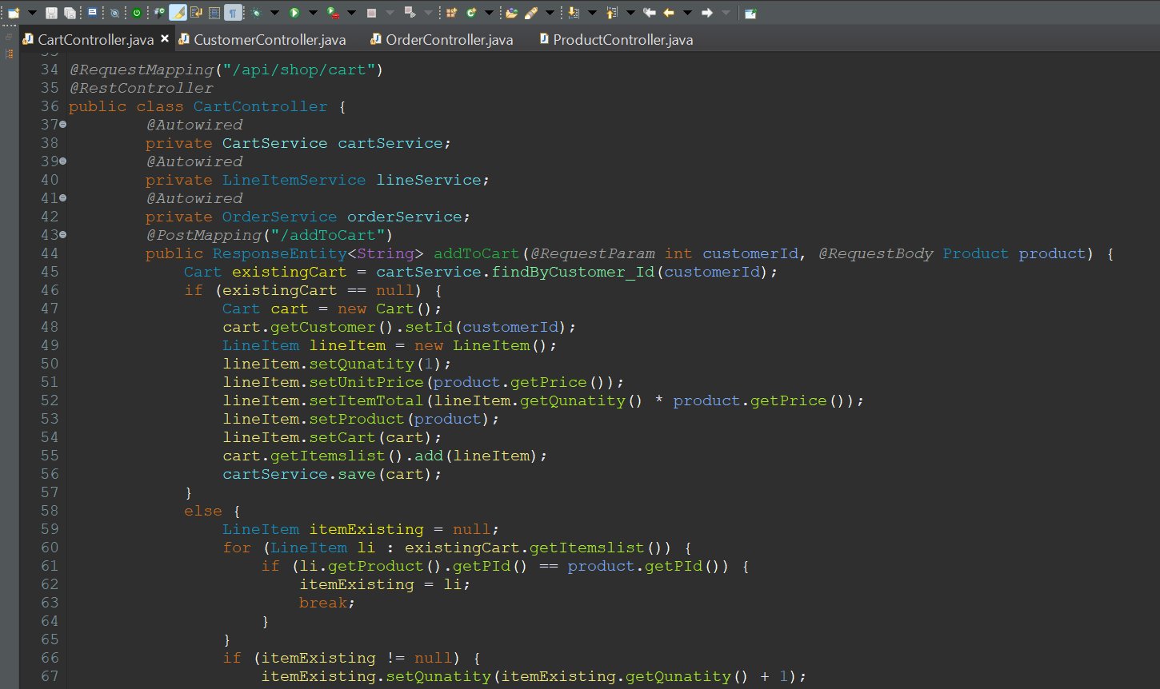
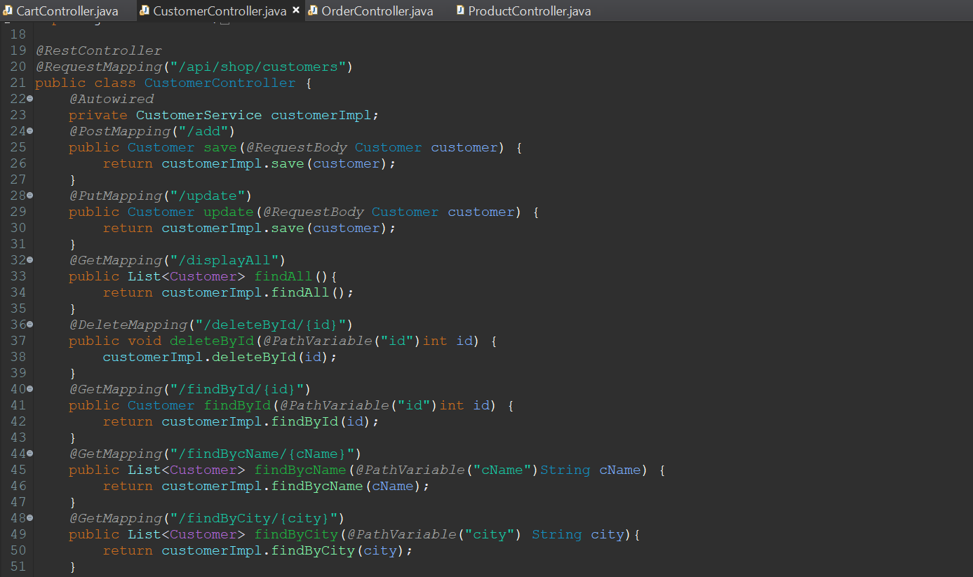
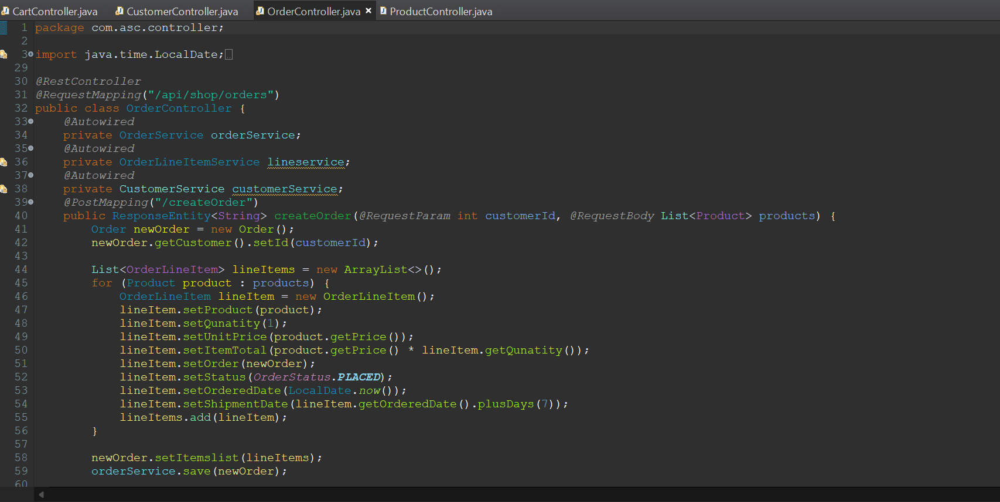
Important areas of the Project with screenshots
Product Controller
Cart Controller
Customer Controller
Order Controller

Slide 11
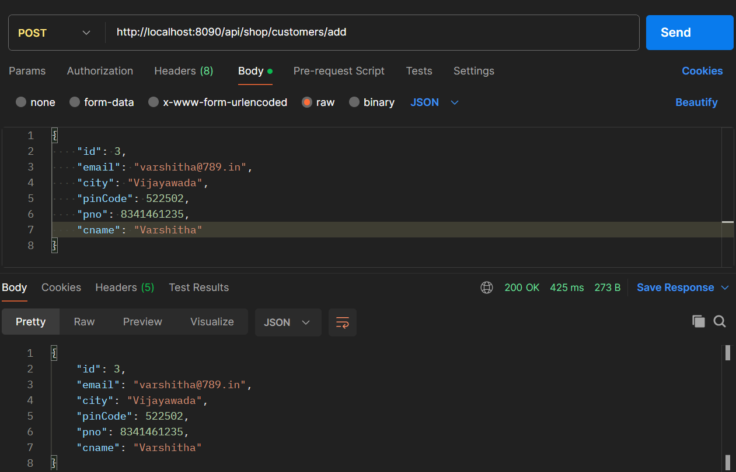
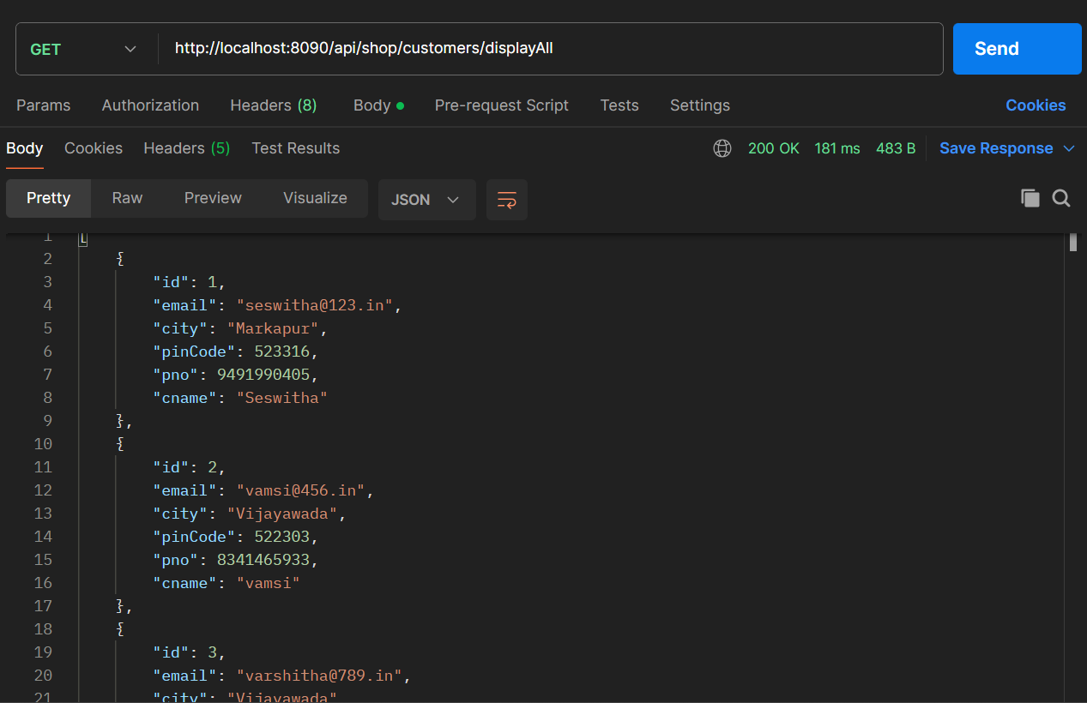
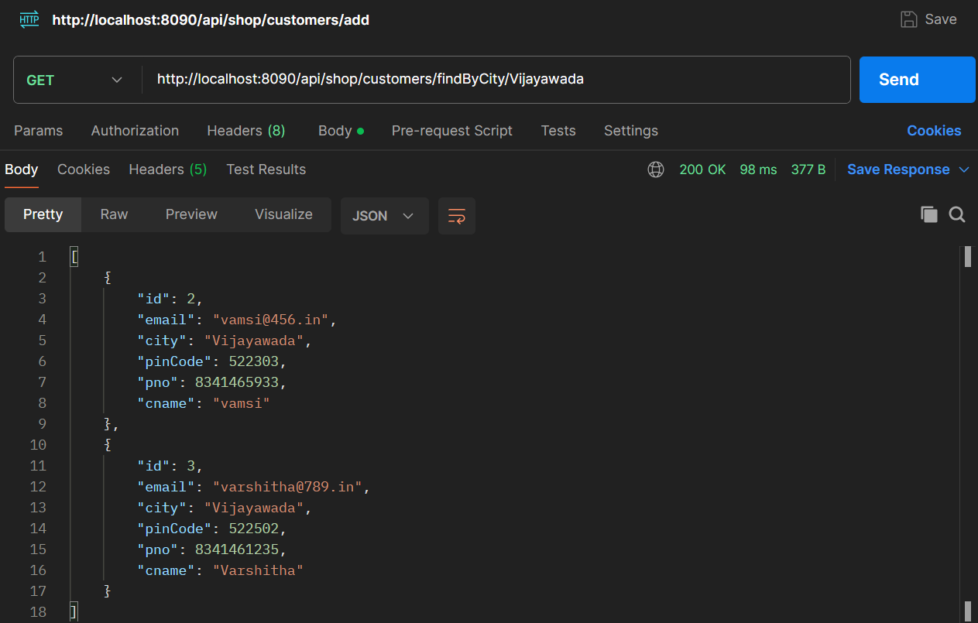
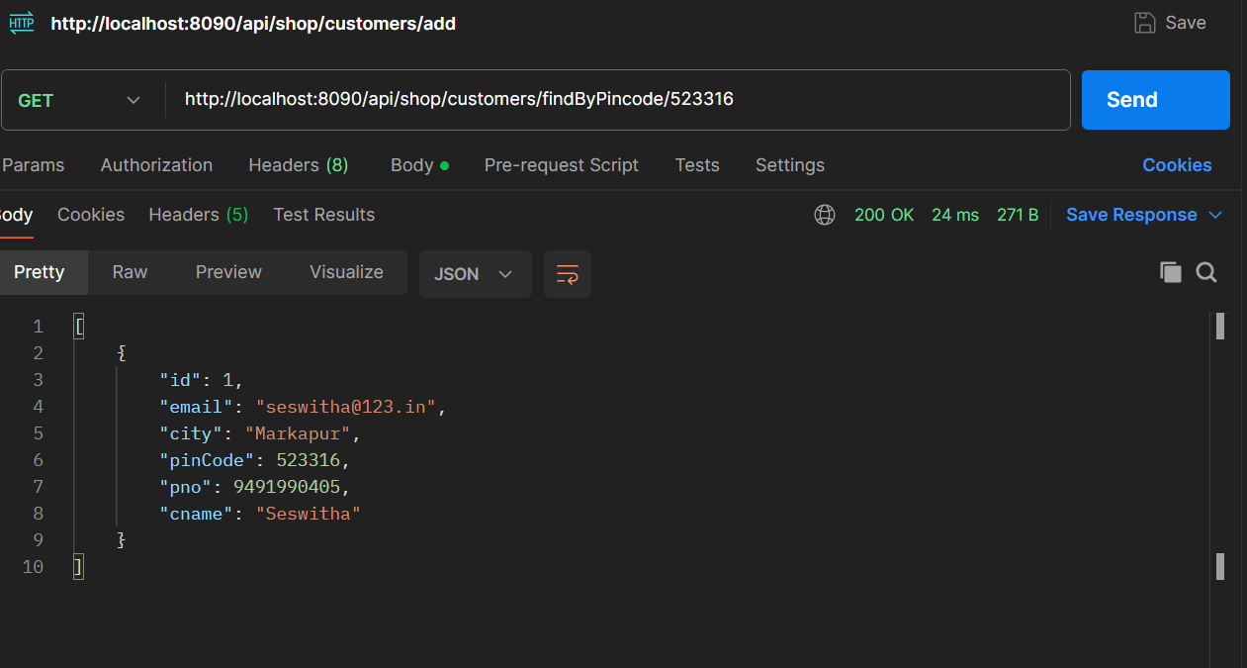
Important areas of the Project with screenshots
Adding Customer
Displaying All the Customers
Finding Customer By their City
Finding Customer By their Pincode

Slide 12
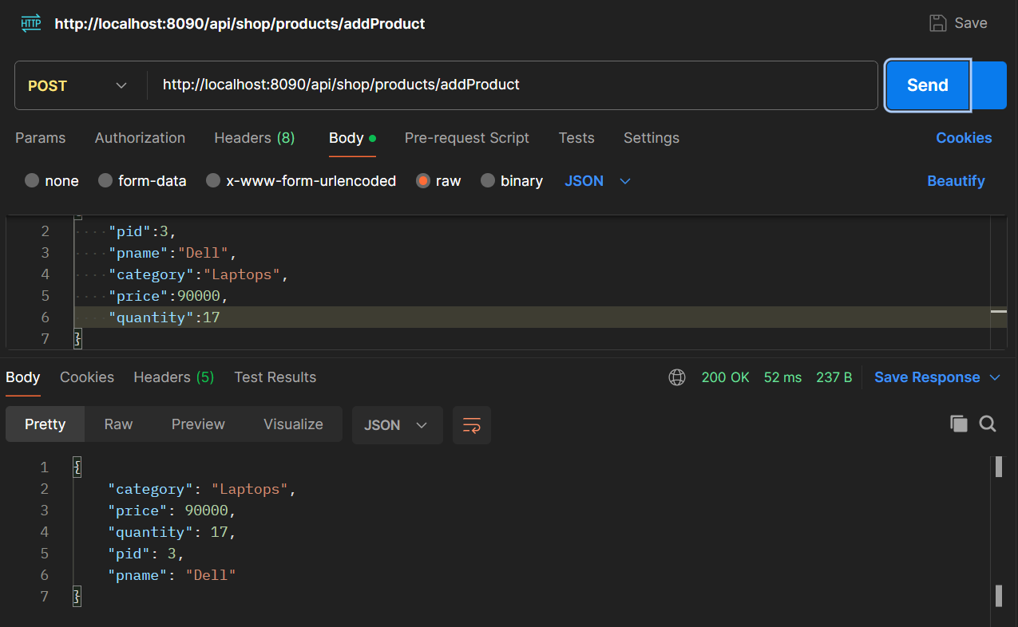
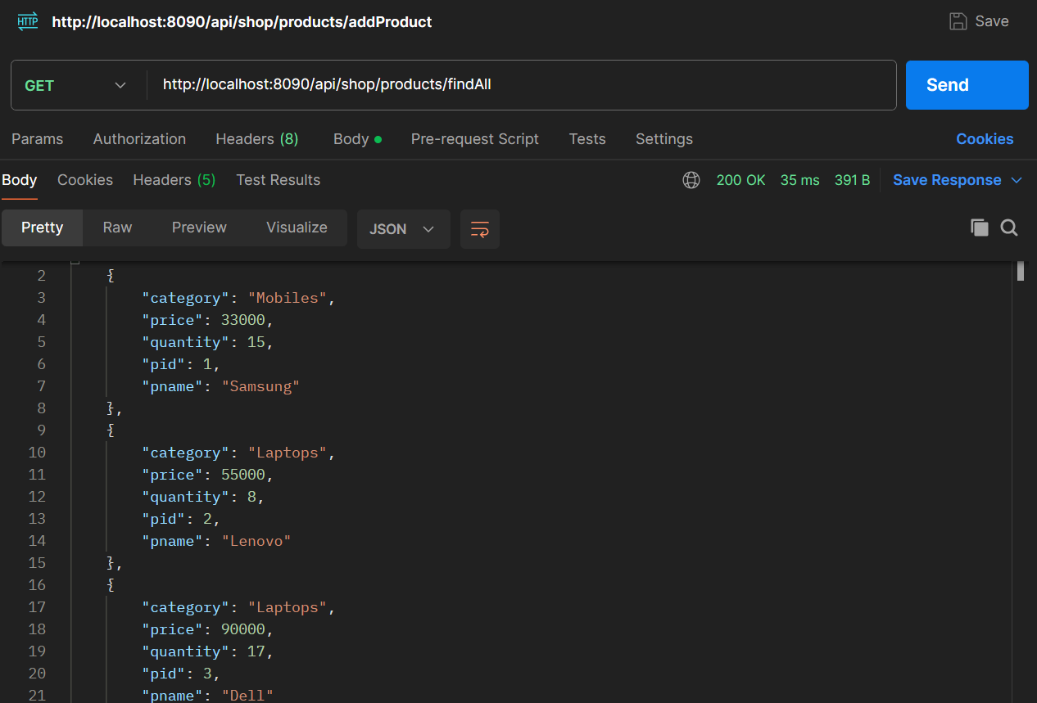
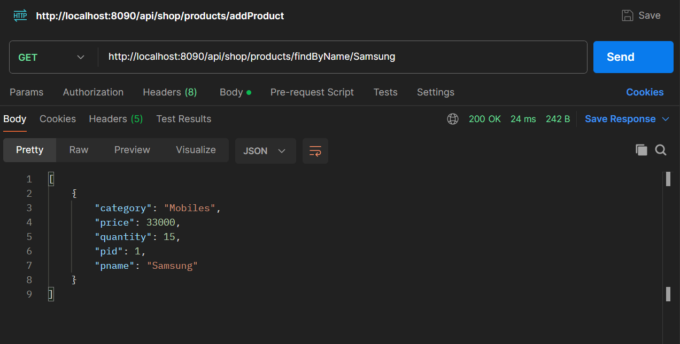
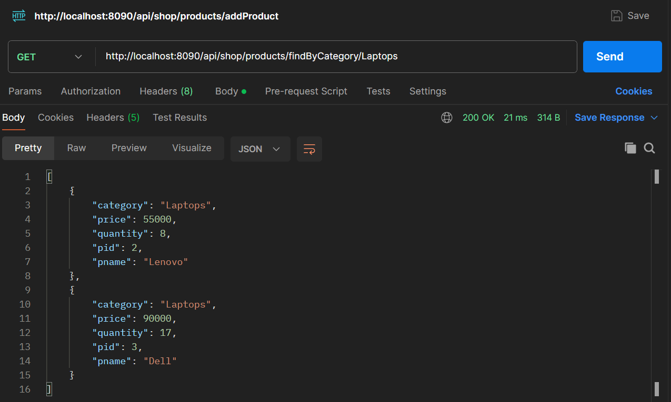
Important areas of the Project with screenshots
Adding Product
Displaying All The Products
Finding Products by Name
Finding Products by Category

Slide 13
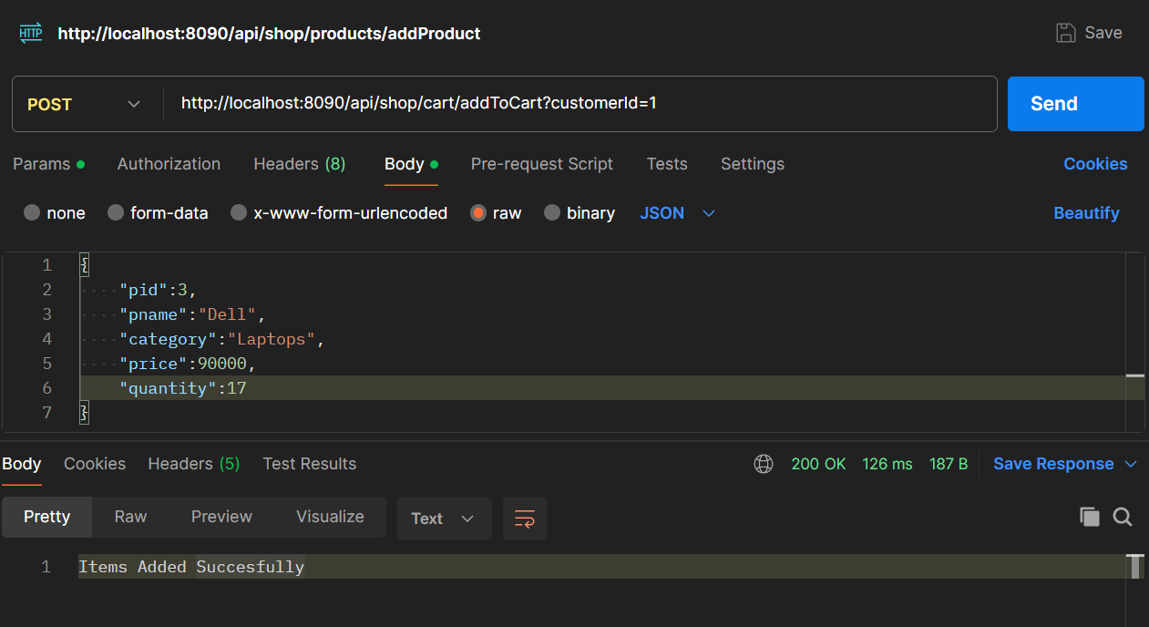
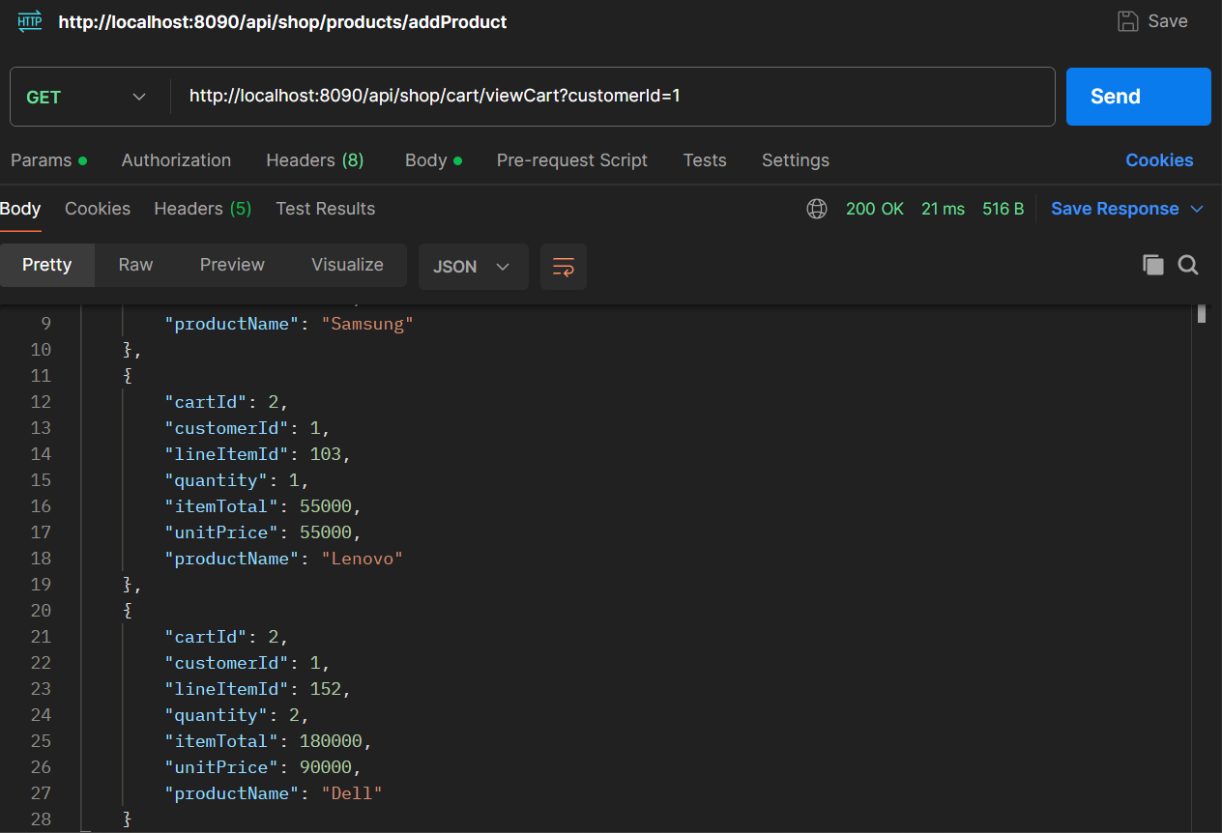
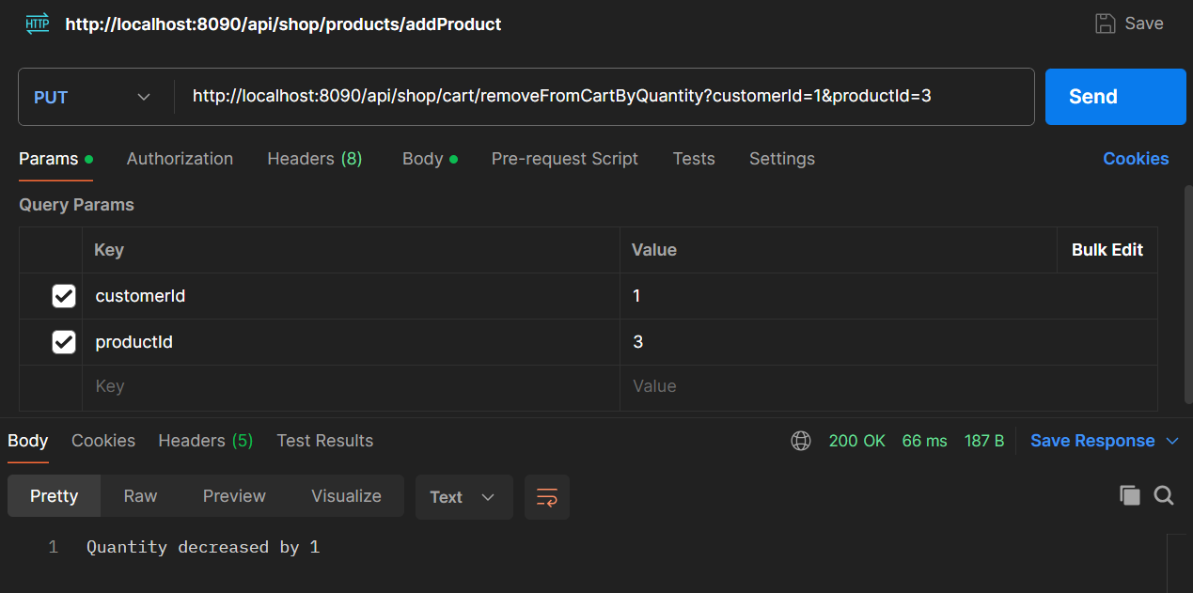
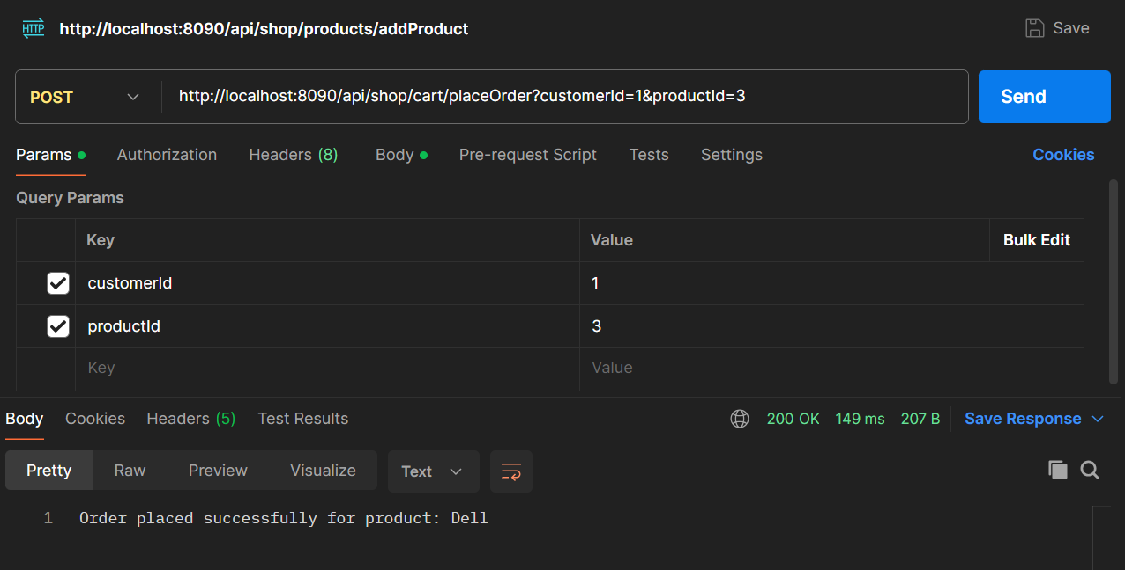
Important areas of the Project with screenshots
Adding Product to Cart
Getting the Cart of a Customer
Removing Product from Cart
Placing Order from Cart

Slide 14
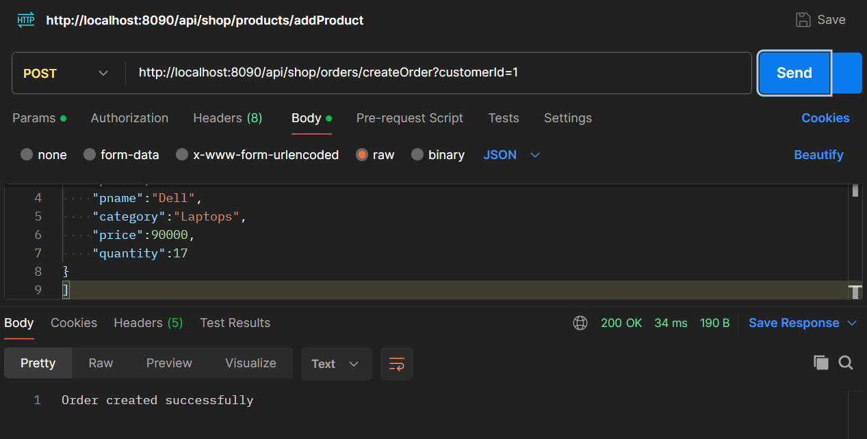
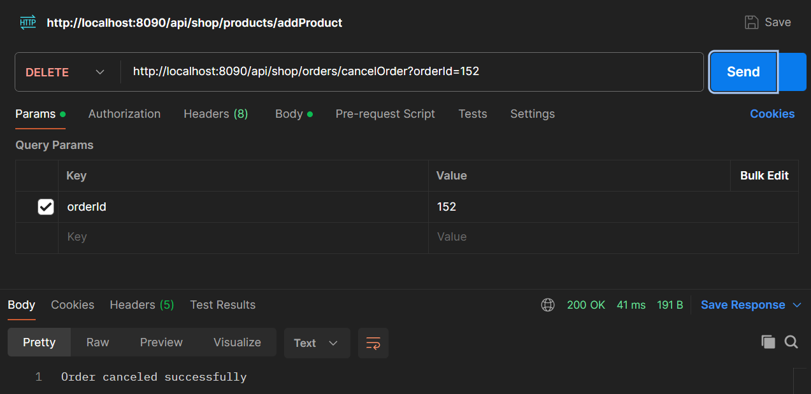
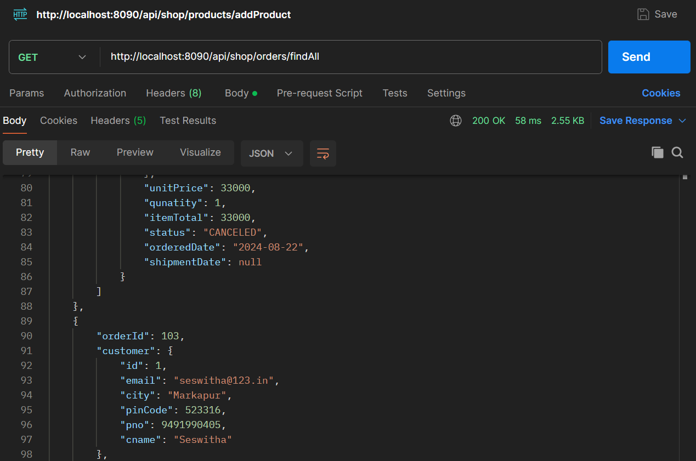
Important areas of the Project with screenshots
Creating Order
Deleting Order
Displaying All the orders

Slide 15
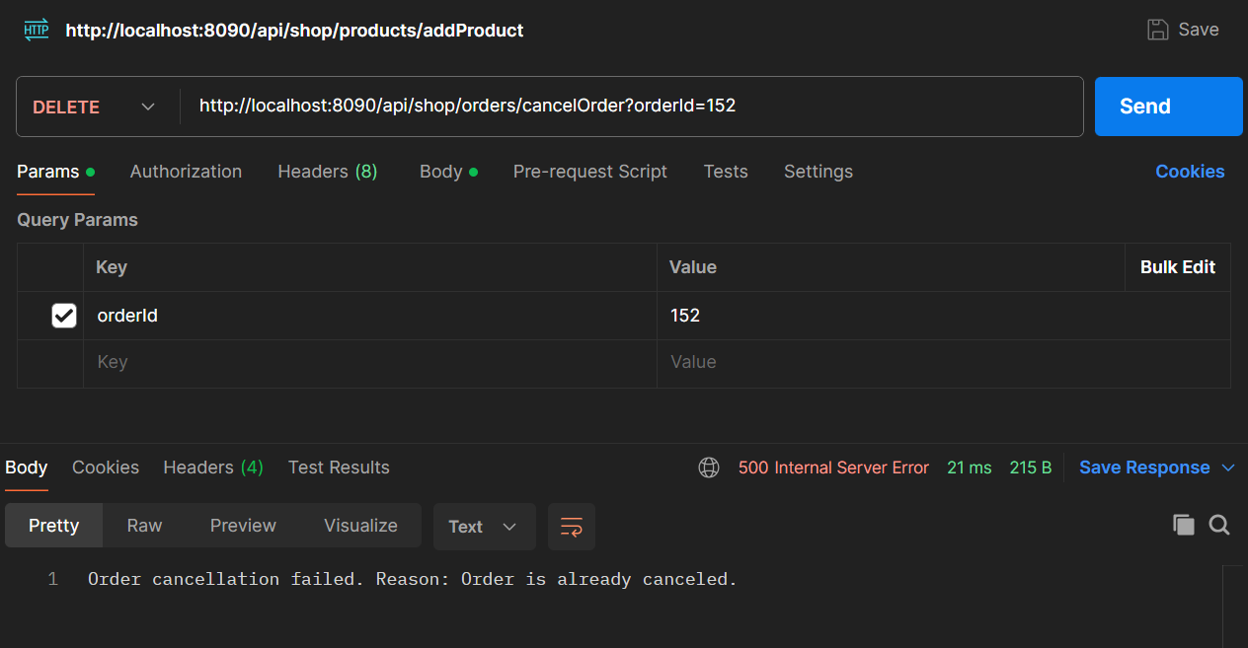
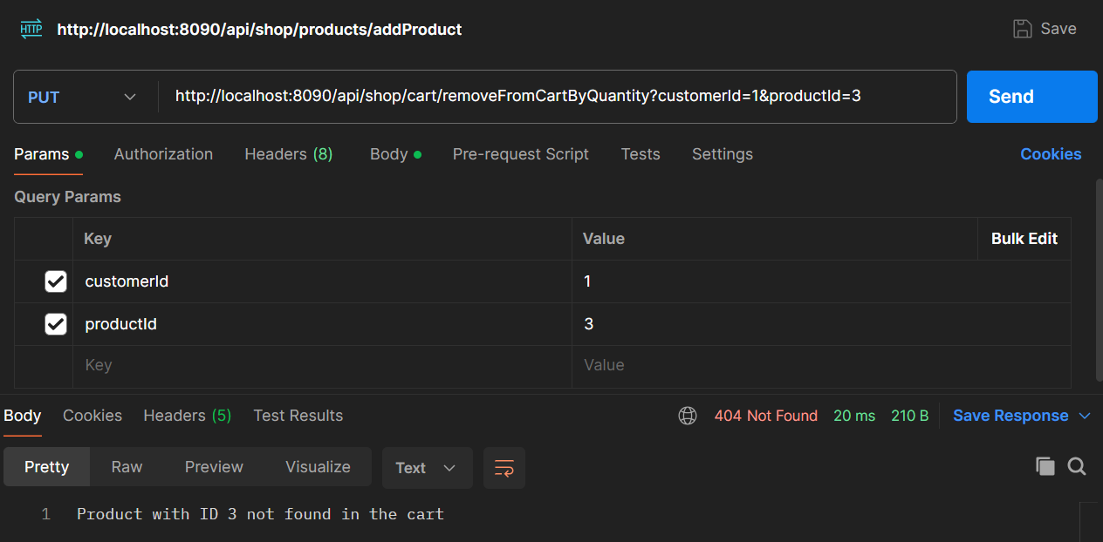
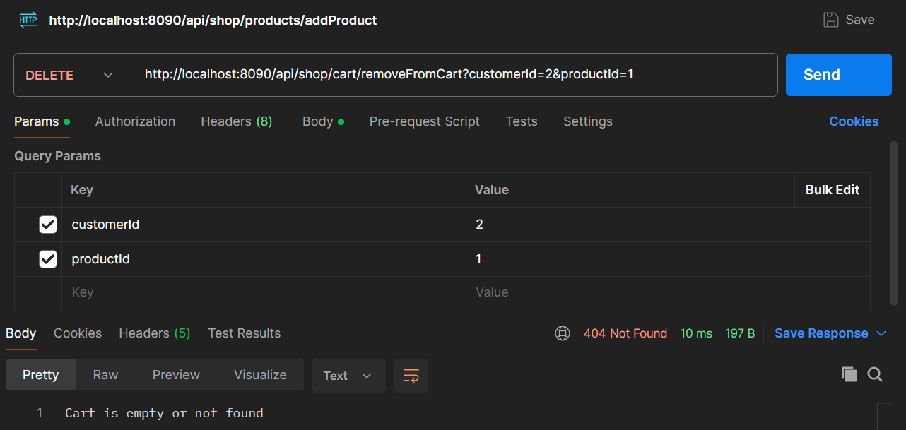
Exceptions added in the project
OrderCanellationNotPossibleException
ProductNotFoundException
CartNotFoundException

Slide 16
Conclusion
Layered Architecture: The application uses a DTO, DAO, Service, and Controller structure, enhancing maintainability, scalability, and separation of concerns.
Data Management: Clear separation between data transfer and data access ensures data integrity and simplifies management.
RESTful API Design: Modular controllers for Cart, Customer, Order, and Product streamline CRUD operations and facilitate future enhancements.
User Experience: The application provides a comprehensive set of features, custom exception handling, and a robust, interactive user experience.
Scalability & Testing: The design supports easy future enhancements and thorough testing, ensuring reliability and ease of integration.
Documentation: Clear API documentation and data models improve usability for developers and stakeholders.

Slide 17
Thank You

